Slide 1
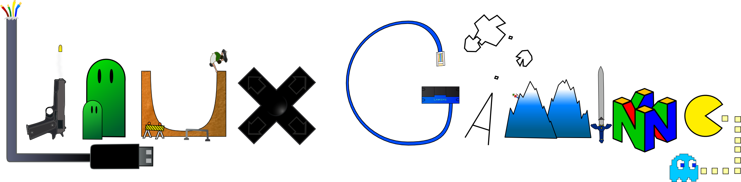

Slide 2
Steam Application
Confirmed working games 1,912
One account to store all your games online
DRM

Slide 3
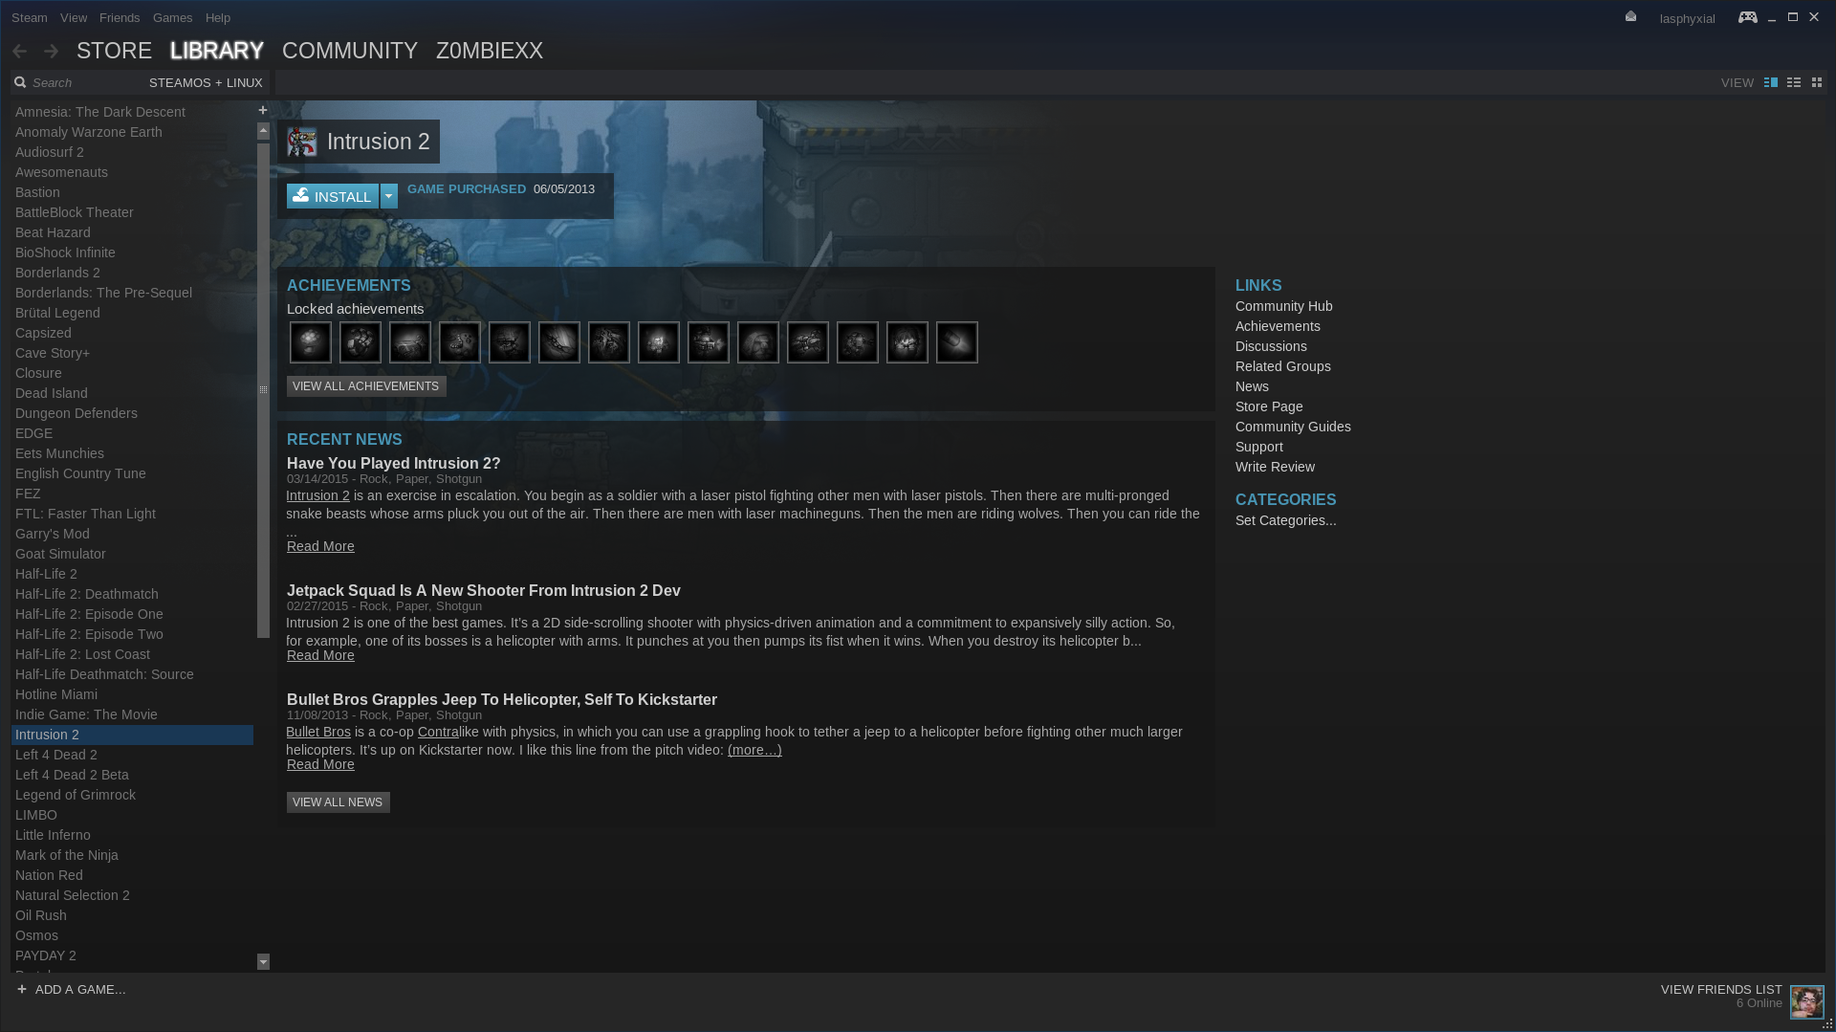

Slide 4
SteamOS
Distribution built strictly for steam(gaming) and media services
Uses Steams “Big Picture Mode”
SteamOS v1 (Debian 7)
SteamOS v2 (Debian 8)
Various third-party drivers and updated graphics stack
Updated kernel tracking the 4.1 longterm branch
Custom graphics compositor
Auto-update from the Valve SteamOS repositories

Slide 5
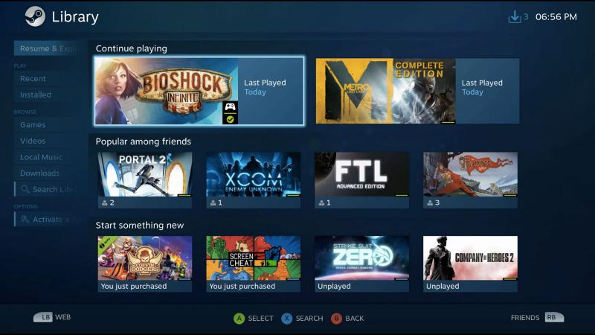

Slide 6
PlayonLinux/Wine
Emulates Windows to an extent to allow more options of games
Allows some none native content to run on linux
Easier interface for easy installation and running of games installed

Slide 7
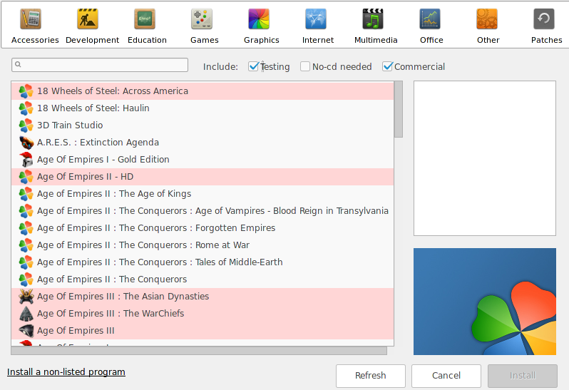

Slide 8
Virtualization
Running Virtual Machines of Windows to run Games and Programs
Allows hardware passthrough for 100% of performance of the hardware
Much more advanced setup and other requires specialized hardware to have it work flawlessly

Slide 9
Links
https://www.reddit.com/r/linux_gaming/
http://store.steampowered.com/steamos/
https://www.gog.com/ (DRM Free Games)
http://www.humblebundle.com/ (DRM and DRM Free)

Slide 10


